Slide 1
Scalable Big Data Processing System with Hybrid Storage Architecture

Slide 2
Key Problem Statement
"Processing diverse data types (text, images, videos) at scale while maintaining optimal performance across different access patterns and storage requirements"

Slide 3
Core Capabilities
Multi dimensional data generation (text, images, videos) in bulk
Multi dimensional data processing
Object storage for raw files
Document store for metadata
Time-series for metrics
Fast searching on big data
Monitoring performance

Slide 4
Design Challenges
Understanding the Requirements
Data Variety Management
Integration of all components
Resource Constraints

Slide 5
Infrastructure Components
Message broker system
Storage systems
Monitoring

Slide 6
Massage Broker System
Kafka: Message broker for handling data streams
Zookeeper: Used by Kafka to coordinate clusters, maintain metadata, track broker availability, facilitate leader election etc.

Slide 7
Storage Systems
MongoDB: For metadata storage (document-oriented)
Elasticsearch: For search indexing
Cassandra: For time-series metrics (processing statistics)
MinIO: S3-compatible object storage for raw data

Slide 8
Monitoring
Prometheus: Metrics collection
Grafana: Metrics visualization

Slide 9
Custom Services
data-generator: Produces synthetic test data
data-processor: Consumes and processes data

Slide 10
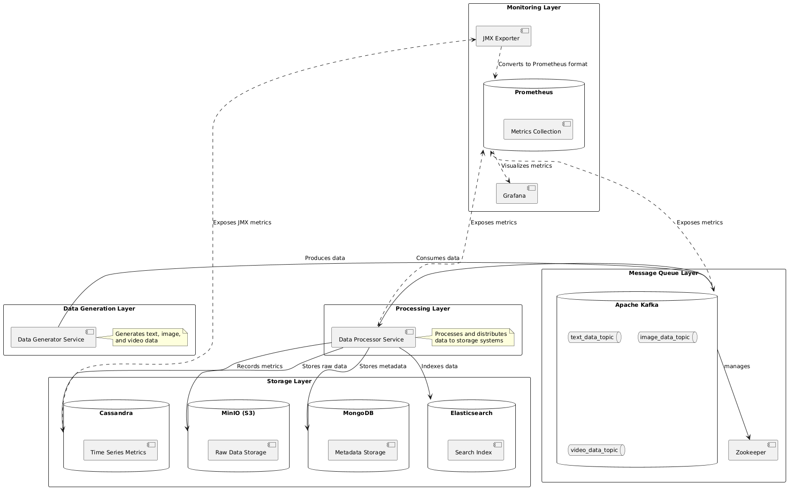

Slide 11
Key Characteristics
Multi-Storage: Different storage systems for different needs
Decoupled Architecture: Components communicate via Kafka
Fault Tolerance: Health checks, restart policies, connection retries
Observability: Comprehensive metrics and logging
Scalability: Kafka allows horizontal scaling of processors

